Slide 1
Introduction to Public Health
Module # 7
Public health nutrition
DR. SHAIKH ABDUS SALAM
Dept. of Public Health
North south University

Slide 2
OBJECTIVES OF THE LECTURE
By the end of this lecture you will be able to:
Conceptualize
  The importance of nutrition in human health
  the impacts of malnutrition.
  Obesity & its causes and prevention
Understand the various steps that can be taken to measure the nutritional status such as BMI or QI etc.
Dr. Shaikh Abdus Salam
1

Slide 3
Concept of Nutrition:
Nutrition can be defined as the process by which living organisms aquire substances called Nutrients for growth, repair and energy. Or
Nutrition may be defined as the science of food and its relationship to health.
Dr. Shaikh Abdus Salam

Slide 4
NUTRIENTS:
Nutrients are specific dietary constituents. They can
be classified into: macronutrients and micronutrients
Dr. Shaikh Abdus Salam

Slide 5
NUTRIENTS:
Nutrients include:
Carbohydrate
Protein
Fat
Vitamins
Minerals
Trace elements
Dietary fibre
Water
Dr. Shaikh Abdus Salam

Slide 6
Food
Foods are substances containing nutrients
They are needed for:
  Cell repair
  Cell growth
  Energy
  Protection
Dr. Shaikh Abdus Salam

Slide 7
Nutrition and its importance
Balanced diet
  Proper quantities
  Proportion of foods
  Maintaining health and growth
Why nutrition is important
  Food provides energy, protein, essential fats, vitamins and minerals
  To live, grow and function properly
  Wide variety of different foods to provide the right amounts of nutrients

Slide 8
Important elements of nutrition
Carbohydrate
  Main energy source for the brain
  Without carbohydrates, the body could not function properly
  Sources: fruits, breads and grains, starchy vegetables and sugars
  Whole grains and fruit are full of fiber, which reduces the risk of coronary heart disease and helps maintain normal blood glucose levels

Slide 9
Protein
  Major structural component of cells
  Responsible for the building and repair of body tissues
  Sources: low-fat meat, dairy, beans or eggs
  Keeps immune system strong and allows body to move and bend
Fat
  Fat is an energy source
  Insulate body, allowing you to maintain your body temperature
  Sources: nuts, high-fat meats and full-fat dairy

Slide 10
Vitamin
  Helps to grow and develop
  13 vitamins in total, categorized by how body absorbs them
  Fat-soluble vitamins, which include vitamins A, D, E and K, need fat to be absorbed properly
  Water-soluble vitamins -vitamin C and the B vitamins dissolve in water before entering your bloodstream
  Vitamin C provides structure to blood vessels, bone and ligaments

Slide 11
Mineral
  Like vitamins, minerals allow to grow and develop properly
  Minerals are divided into two classes based on how much of each nutrient body needs
    Major minerals – sodium, potassium, calcium, phosphorus, magnesium, sulfur and chloride – in large amounts
    Trace minerals – copper, fluoride, zinc, iron, chromium, iodine are needed in small amounts
  Sources: bananas, potatoes, tomatoes, milk, low-fat cheese and yogurt

Slide 12
Water
  Water is more than a thirst quencher
  A major nutritional element that helps regulate body temperature, lubricate joints and protect major organs and tissues
  Also helps transport important substances, like oxygen, throughout body
  Aim to drink adequate amount of water every day.

Slide 13
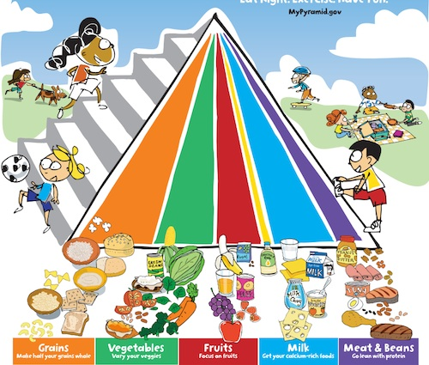

Slide 14
Malnutrition
The condition when the body does not get the right amount of the vitamins, minerals, and other nutrients it needs to maintain healthy tissues and organ function
Causes of malnutrition
  Poverty and lack of food
  Loss of appetite
  Chronic diseases
  Drug or alcohol dependencies
  Eating disorders: anorexia or bulimia
Notes:
especially disease of the intestinal tract, kidneys, and liver. Patients with chronic diseases like cancer, AIDS, intestinal parasites, and other gastric disorders may lose weight rapidly and become susceptible to undernourishment because they cannot absorb valuable vitamins, calories, and iron.

Slide 15


Severe Eating Disorders
Anorexia
Bulimia

Slide 16
Malnutrition in Bangladesh
More than half the population suffers from malnutrition
Severe acute malnutrition affects 600,000 children, while close to 2 million children have moderate acute malnutrition
Stunting affects 40% of children under the age of five
1/3 of women are underweight and around 15% have short stature, which increases the risk of difficult childbirth and low-birth-weight infants
Half of all women suffer from anaemia, mostly nutritional in origin
Malnutrition is estimated to cost Bangladesh more than US$1bn every year in lost productivity
Ready-to-use supplementary and therapeutic foods (RUSF and RUTFs) based on locally available ingredients (such as rice, lentils and chickpeas)
Notes:
especially disease of the intestinal tract, kidneys, and liver. Patients with chronic diseases like cancer, AIDS, intestinal parasites, and other gastric disordersmay lose weight rapidly and become susceptible to undernourishment because they cannot absorb valuable vitamins,calories, and iron.

Slide 17
Obesity
Abnormal or excessive fat accumulation that presents a risk to health
Major risk factors for a number of chronic diseases, including diabetes, cardiovascular diseases and cancer
Once considered a problem only in high income countries, now dramatically on the rise in LMIC, particularly in urban settings

Slide 18

Obesity
Anorexia nervosa
Bulimia nervosa

Slide 19
Preventing obesity
Follow a healthy eating plan- balance of energy IN and energy OUT
Focus on portion size
Be active- walk, bike or physical exercise
Reduce screen time- use of TVs, computers, DVDs, and videogames because they limit time for physical activity
Keep track of your weight, body mass index, and waist circumference

Slide 20
Calculate Your Body Mass Index (BMI)
A common method of evaluating your weight
BMI= body weight (in Kg)/height (m)²

Slide 21
BMI Intervals
Under weight
Normal weight
Overweight
Obese
Less than 18.5
18.5-24.9
25-29.9
30 and above

Slide 22
Factors in relation to Food
The important factors in relation to Food
are:
Energy Value
Quality and Quantity of Primary Foods
Variation in the diet
Digestibility
Cooking
Psychological factors
Cost
Dr. Shaikh Abdus Salam

Slide 23
RDA#Recommonded Dietery Allowence
Carbohydrate = 50% - 65%
Protein = 15%-20%
Fat = 25%-30%
Dietary Fiber = 25 -40 gram/ day Approx.
Fresh vegetables+ fresh Fruits = Plenty if calorie free or zero kcal.
Table salt = Less than 5 gm/day
Water = for one kcal one ml of water plus daily loss.
Dr. Shaikh Abdus Salam

Slide 24
Role of Proteins in the Diet
Replacement of cells
Growth
Large molecules
  Smaller molecules called Amino Acids
Found in meats, eggs, beans
Dr. Shaikh Abdus Salam

Slide 25
Role of Carbohydrates
Primary energy source
Molecules of C, H, O
  Sugars ~ simple carbohydrates
  Starches ~ complex carbohydrates
  Fiber
Dr. Shaikh Abdus Salam

Slide 26
Role of Fats
Provide energy / stores energy
Absorb vitamins
Make up cell membranes
Dr. Shaikh Abdus Salam

Slide 27
Role Of Vitamins
Organic (contain carbon)
Growth
Regulate body functions
Prevent disease
No food has all vitamins
Water soluble
Fat soluble
  Stored in body
Dr. Shaikh Abdus Salam

Slide 28
Role Of Minerals
Inorganic (no carbon)
Control chemical reactions
Build cells
Conduct nerve impulses
Carry oxygen
Dr. Shaikh Abdus Salam

Slide 29
Minerals
Some minerals are always required
Fruits, vegetables and cereals are the chief sources of minerals
Milk products supply the majority of calcium and phosphorous
Dr. Shaikh Abdus Salam

Slide 30
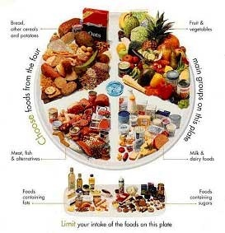
Minerals
Dr. Shaikh Abdus Salam

Slide 31
Minerals
Phosphorous:
Children should take 1 g per day, adults 1.3 g and a pregnant or lactating woman 1.9 g
Sources of phosphorous are meat, fish, milk, cheese and eggs. Vegetable foods such as beans, oatmeal and lentils
Iron:
Deficiency leads to anemia
Sources are bread, meat and potatoes. Also liver, kidney, egg yolk, green peas, cabbage, carrots
Only 10% of iron is absorbed
Children up to 12 years require 15-20 mg. daily, adult 40 mg. and pregnant and lactating women 50 mg
Dr. Shaikh Abdus Salam

Slide 32
Minerals
Calcium:
Increased amount of calcium is required by children, pregnant and lactating women
The average intake should be about 800 mg per day
Best sources are milk and cheese. Other sources are eggs, green vegetables, oranges, nuts, beans, carrots eggs
Dr. Shaikh Abdus Salam

Slide 33
Minerals
Iodine:
The daily requirement of iodine is 0.05 mg. and is obtained from water, vegetables and fish
Simple goitre results due to dietary deficiency
Magnesium:
The average daily consumption of about 0.2 is sufficient
Sources are meat, green vegetables and bread
Copper:
The daily requirment is 2 mg.
Sources are liver, cocoa, nuts
Dr. Shaikh Abdus Salam

Slide 34
Minerals
Sodium Chloride:
Usually 20 gm is consumed per day
The intake of salt is required only if abnormal quantities are lost e.g. severe exercise due to sweat; diarrhea
Heat stroke is prevented by ingestion of salt solutions instead of water
Dr. Shaikh Abdus Salam

Slide 35
Water
Nutrients carried in water
Used in chemical reactions
Dr. Shaikh Abdus Salam

Slide 36
Nutrition - use of food by organisms
Energy/material providing nutrients Macronutrients: Protein, carbohydrate and lipid
Micronutrients: Vitamins and minerals necessary for biochemical processes
Essential fiber: Non-digestible polysaccharide material, essential for normal functioning of animal digestive systems (i.e. colon)
Dr. Shaikh Abdus Salam

Slide 37
Trace elements
Trace elements: Substances which require very small amount
Dr. Shaikh Abdus Salam

Slide 38
FOOD CLASSIFICATION:
Many ways we can classify foods e.g.-
(1) By origin– a. Foods of animal origin
b. Foods of Plant origin.
(2)By chemical composition–
a.Protein, b.fat
c. Carbohydrate, d. Vitamins, e. Minarals etc.
Dr. Shaikh Abdus Salam

Slide 39
FOOD CLASSIFICATION (contd):
3) By predominant functions-
a. Body-building foods-Meat, fish, Milk, Pulses etc.
b. Energy giving foods-cereals,sugars, roots etc.
c. Protective foods-vege,milk & fruits
Dr. Shaikh Abdus Salam

Slide 40
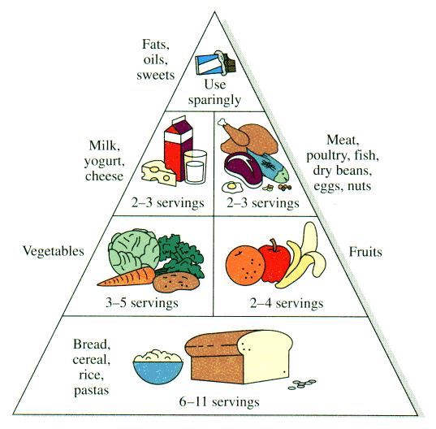
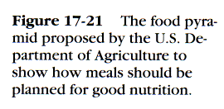
Food Pyramid
Dr. Shaikh Abdus Salam

Slide 41
Components of Natural Foods
Carbohydrates
Proteins
Fats
Vitamins
Minerals with trace elements
Fiber
Water
Dr. Shaikh Abdus Salam

Slide 42
FDA Daily Dietary Recommendations
60% of daily caloric intake (250 g of polysaccharides)
50 g or less of simple sugars (mono- and di-saccharides such as table sugar)
20-30 g of fiber
Dr. Shaikh Abdus Salam

Slide 43
FDA Recommendations
Fats limited to 30% of caloric intake
No more than one-third of fats should be saturated
Unsaturated fats should be mostly cis- rather than trans-structures (next slide)
Dietary cholesterol should be below 300 mg/day
Dr. Shaikh Abdus Salam

Slide 44
Vitamins
Organic compounds essential in the diet in small amounts but have little or no caloric value
Non-polar or fat soluble are A, D, E, K
Polar or water soluble are B and C
Antioxidants are A, C,and E
Vitamin A comes from carotene(carrots)
Dr. Shaikh Abdus Salam

Slide 45
Minerals
Minerals are inorganic substances that are required by a living system to sustain life
In some cases metal ions needed to make enzymes function
Iron is needed to make hemoglobin which carries oxygen
Usually water soluble
Dr. Shaikh Abdus Salam

Slide 46
FOODs
Food Safety
Food Security
Food quality
Dr. Shaikh Abdus Salam

